Slide 1


Slide 2
Data Science Dept
Doundoulakis Stavros
Spiridon Spiros
Project:
ML in FC24 : Players’ Value Prediction in Ultimate Team Mode
Ultimate Team Mode (FUT):
The goal of Ultimate Team is to assemble your dream squad.
Just like in real life football, there is a transfer market within FUT.
Most profitable Mode in FC24.

Slide 3
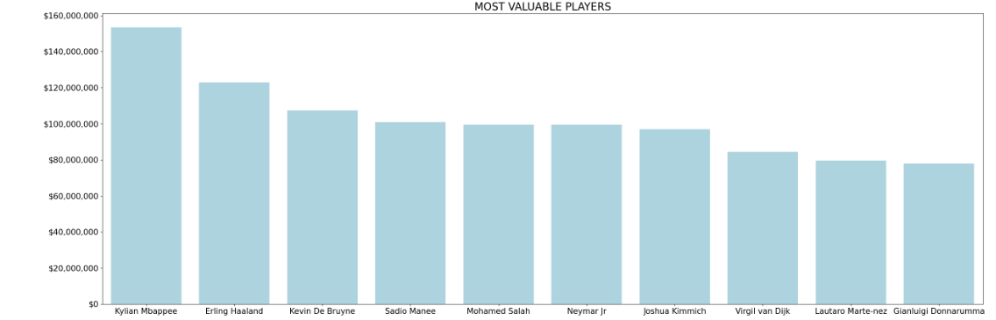

Slide 4
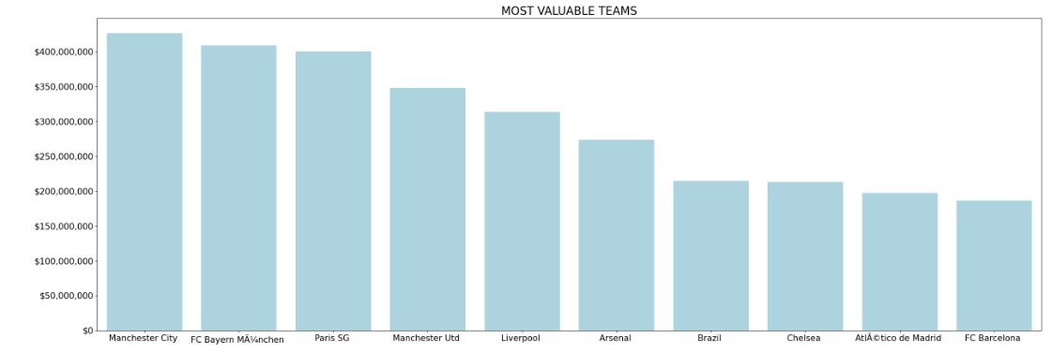

Slide 5
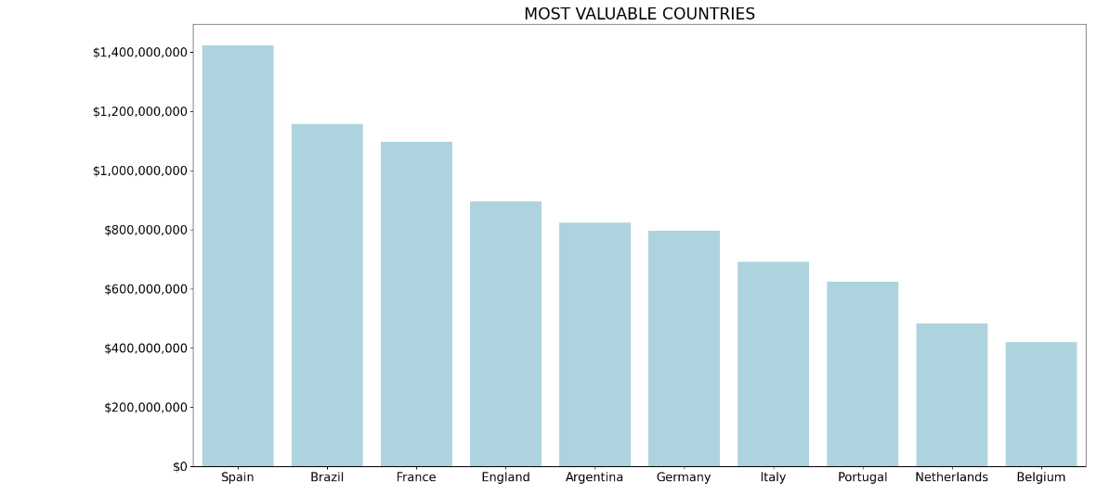

Slide 6
For the accomplishment of this project, we trained various kinds of algorithms.
Training results:
Correct Predictions: 75%
Margin of Error: ±3.5M

Slide 7
Best traits to evaluate the market value of a player:
Reactions
Height
Composure
Shot power
Short pass
Vision
Ball control
Long pass
Age
Stamina

